Slide 1
Security Hardening – Case Study – Win 10
Windows 10
DISA, Release 9
28 April 2017

Slide 2
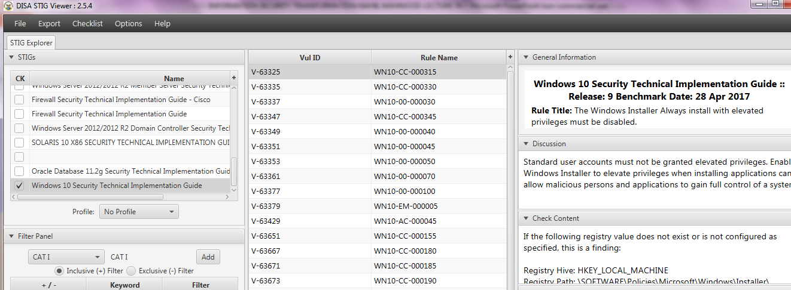
Security Hardening – Case Study – Win 10
STIGVIEWER WINDOW

Slide 3
Security Hardening – Case Study – Win 10
General Information:
Rule Title: The antivirus program must be configured to update signature files on a daily basis.
STIG ID: WN10-00-000046
Severity: CAT I

Slide 4
Security Hardening – Case Study – Win 10
Discussion:
Virus scan programs are a primary line of defense against the introduction of viruses and malicious code that can destroy data and even render a computer inoperable. Using a virus scan program provides the ability to…

Slide 5
Security Hardening – Case Study – Win 10
Discussion…:
…detect malicious code before extensive damage occurs. Updated virus scan data files help protect a system, as constantly changing malware is identified by the antivirus software vendors

Slide 6
Security Hardening – Case Study – Win 10
Check Content:
This requirement is NA if McAfee VirusScan Enterprise (VSE) is used. It will be addressed with the corresponding McAfee VSE STIG.
Configurations will vary depending on the product.

Slide 7
Security Hardening – Case Study – Win 10
Fix Text:
Configure the antivirus program to update signature files at least daily. Ensure the updates are occurring on timely basis and are not more than a week old.

Slide 8
Security Hardening – Case Study – Win 10
CCI (Control Correlation Identifier):
CCI: 000366 The org implements the security config settings. NIST SP 800-53 :: CM-6 b NIST SP 800-53A :: CM-6.1 (iv) NIST SP 800-53 Revision 4 :: CM-6
END

